Slide 1
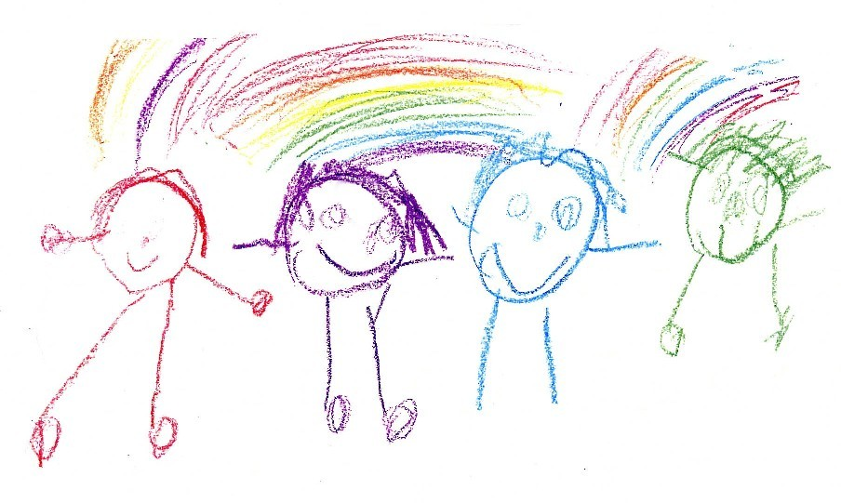

You draw, I guess

Slide 2
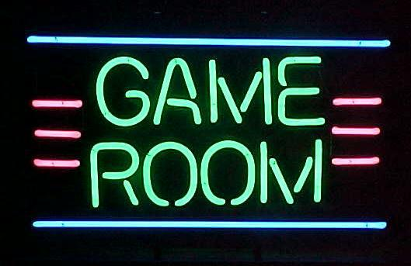

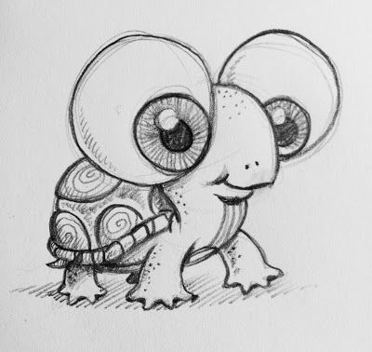


Slide 3
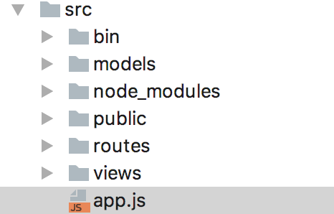
Our architecture
Model–view–controller (MVC) -
For implementation of interfaces

Slide 4
Sprint 1 Capstone

